Slide 1
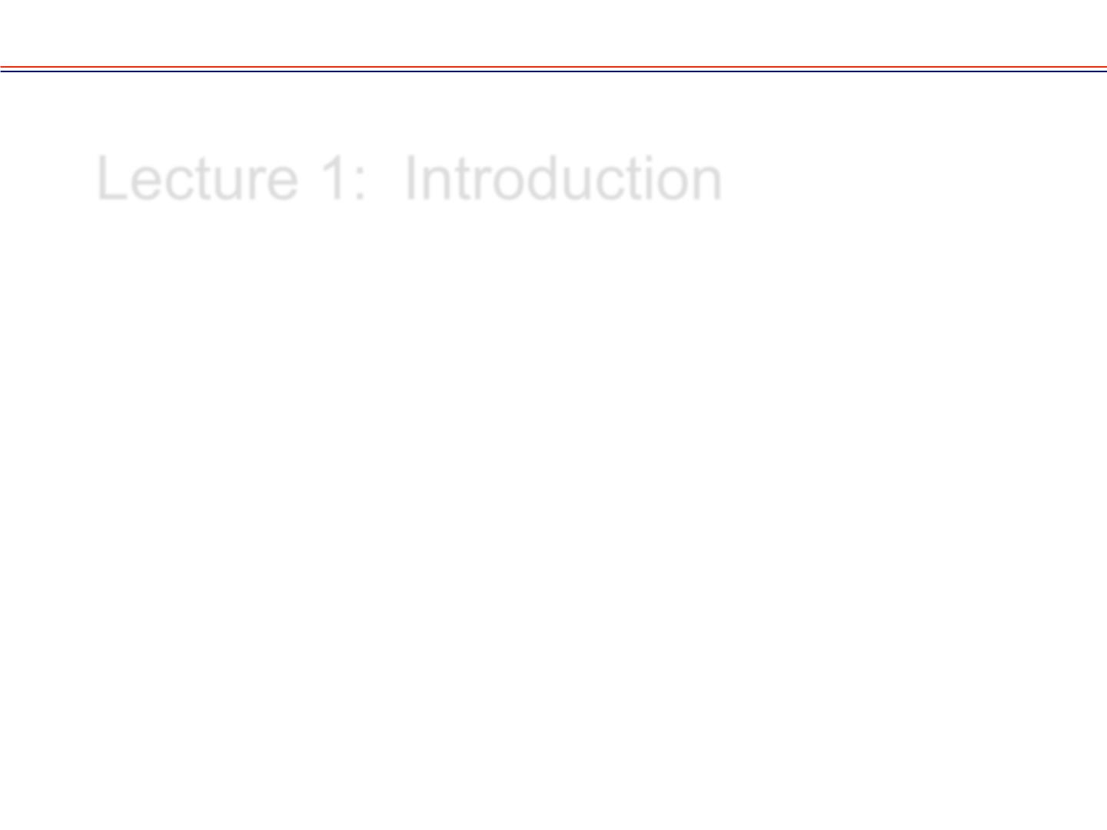
Lecture 1: Arithmetic-logic units
Computer Architecture
Roy Vellaisamy
Professor of Intelligent systems
University of Glasgow
https://www.gla.ac.uk/schools/engineering/staff/royvellaisamy/

Slide 2
Arithmetic-logic units
An arithmetic-logic unit, or ALU, performs many different arithmetic and logic operations. The ALU is the “heart” of a processor—you could say that everything else in the CPU is there to support the ALU.
Here’s the plan:
  Learn an arithmetic unit first, by building off ideas from the adder-subtractor circuit.
  Then logic operations, and build a logic unit.
  Finally, put these pieces together using multiplexers.

Slide 3
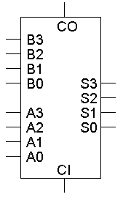
The four-bit adder
The basic four-bit adder always computes S = A + B + CI.
But by changing what goes into the adder inputs A, B and CI, we can change the adder output S.
This is also what we did to build the combined adder-subtractor circuit.

Slide 4
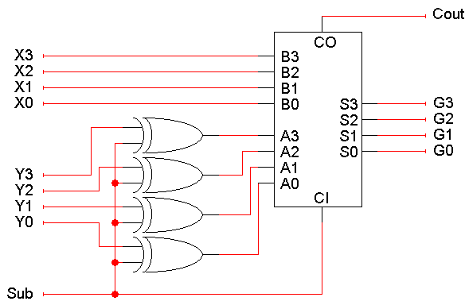
It’s the adder-subtractor again!
Here the signal Sub and some XOR gates alter the adder inputs.
  When Sub = 0, the adder inputs A, B, CI are Y, X, 0, so the adder produces G = X + Y + 0, or just X + Y.
  When Sub = 1, the adder inputs are Y’, X and 1, so the adder output is G = X + Y’ + 1, or the two’s complement operation X - Y.

Slide 5
The multi-talented adder
So we have one adder performing two separate functions.
“Sub” acts like a function select input which determines whether the circuit performs addition or subtraction.
Circuit-wise, all “Sub” does modify the adder’s inputs A and CI.

Slide 6
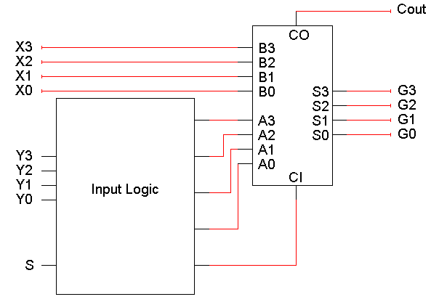
Modifying the adder inputs
By following the same approach, we can use an adder to compute other functions as well.
We just have to figure it out which functions we want, and then put the right circuitry into the “Input Logic” box .

Slide 7
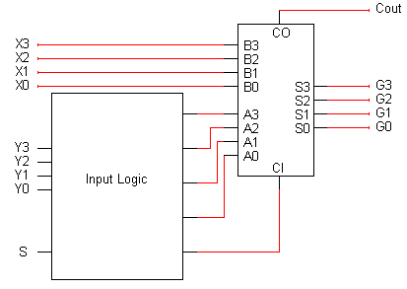
Some more possible functions
We already saw how to set adder inputs A, B and CI to compute either
X + Y or X - Y.
How can we produce the increment function G = X + 1?
How about decrement: G = X - 1?
How about transfer: G = X?
This is almost the same as the
increment function!
One way: Set A = 0000, B = X, and CI = 1
A = 1111 (-1), B = X, CI = 0
A = 0000, B = X, CI = 0

Slide 8
The role of CI
The transfer and increment operations have the same A and B inputs, and differ only in CI.
In general we can get additional functions by manipulating CI = 0 /1.
Another example:
  Two’s-complement subtraction is obtained by setting A = Y’, B = X, and CI = 1, so G = X + Y’ + 1.
  If we keep A = Y’ and B = X, but set CI to 0, we get G = X + Y’. This turns out to be a subtraction operation.

Slide 9
Table of arithmetic functions
Here are some of the different possible arithmetic operations.
We’ll need some way to specify which function we’re interested in, so we’ve randomly assigned a selection code to each operation.
S2 | S1 | S0 | Arithmetic operation
0 | 0 | 0 | X (transfer)
0 | 0 | 1 | X + 1 (increment)
0 | 1 | 0 | X + Y (add)
0 | 1 | 1 | X + y + 1 (add)
1 | 0 | 0 | X + y' (2C subtraction)
1 | 0 | 1 | X + y' + 1 (2C subtraction)
1 | 1 | 0 | X - 1 (decrement)
1 | 1 | 1 | X (transfer)

Slide 10
Mapping the table to an adder
This second table shows what the adder’s inputs should be for each of our eight desired arithmetic operations.
  Adder input CI is always the same as selection code bit S₀.
  B is always set to X.
  A depends only on S₂ and S₁.
These equations depend on both the desired operations and the assignment of selection codes.
Selection code |  |  | Desired arithmetic operation | Required adder inputs
S1 | S2 | S0 | G(A + B + CI) | A | B | CI
0 | 0 | 0 | X (transfer) | 0000 | X | 0
0 | 0 | 1 | X + 1 (increment) | 0000 | X | 1
0 | 1 | 0 | X + Y (add) | Y | X | 0
0 | 1 | 1 | X + y + 1 (add) | Y | X | 1
1 | 0 | 0 | X + y' (2C subtraction) | Y' | X | 0
1 | 0 | 1 | X + y' + 1 (2C subtraction) | Y' | X | 1
1 | 1 | 0 | X - 1 (decrement) | 1111 | X | 0
1 | 1 | 1 | X (transfer) | 1111 | X | 1

Slide 11
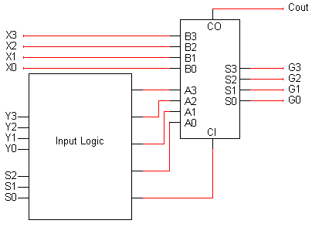
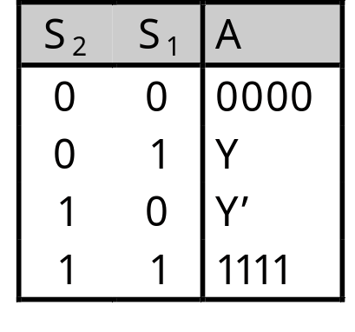
Building the input logic
All we need to do is compute the adder input A, given the arithmetic unit input Y and the function select code S (actually just S₂ and S₁).
Here is an abbreviated truth table:
We want to pick one of these four possible values for A, depending on S₂ and S₁.

Slide 12
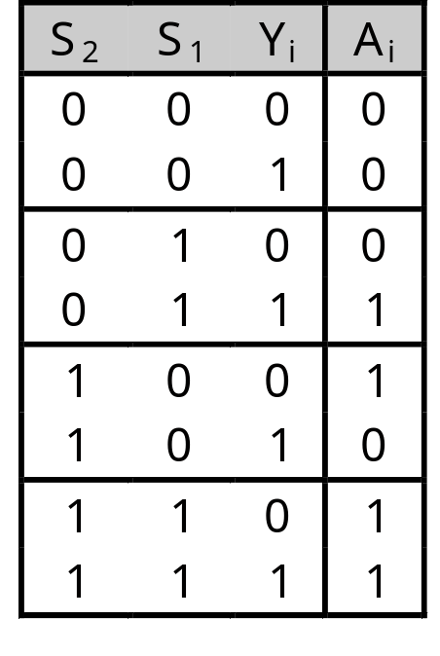
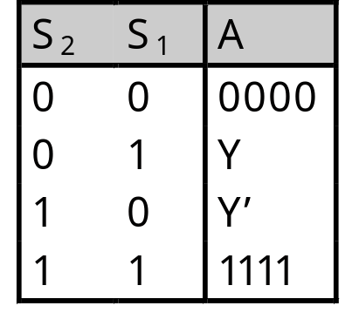
Primitive gate-based input logic
We could build this circuit using primitive gates.
If we want to use K-maps for simplification, then we should first expand out the abbreviated truth table.
  The Y that appears in the output column (A) is actually an input.
  We make that explicit in the table on the right.
Remember A and Y are each 4 bits long!

Slide 13
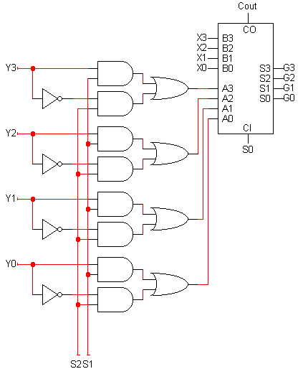
Primitive gate implementation
From the truth table, if we use the following equation,
Again, we have to repeat this once for each bit Y3-Y0, connecting to the adder inputs A3-A0.
This completes our arithmetic unit.
A_{i} = S₂Y_{i}’ + S₁Y_{i}

Slide 14
Bitwise operations
Most computers also support logical operations like AND, OR and NOT, but extended to multi-bit words instead of just single bits.
To apply a logical operation to two words X and Y, apply the operation on each pair of bits X_{i} and Y_{i}:
1 0 1 1
AND 1 1 1 0
1 0 1 0
1 0 1 1
OR 1 1 1 0
1 1 1 1
1 0 1 1
XOR 1 1 1 0
0 1 0 1

Slide 15
Bitwise operations in programming
Languages like C, C++ and Java provide bitwise logical operations:
& (AND) | (OR) ^ (XOR) ~ (NOT)
These operations treat each integer as a bunch of individual bits:
13 & 25 = 9 because 01101 & 11001 = 01001
They are not the same as the operators &&, || and !, which treat each integer as a single logical value (0 is false, 1 is true):
Bitwise operators are often used in programs to set a bunch of Boolean options, or flags, with one argument.
Easy to represent via set theory
“1” is member, “0” not a member. Unions (∪): OR, Intersections (∩): AND

Slide 16
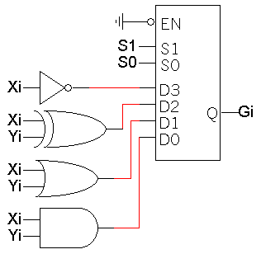
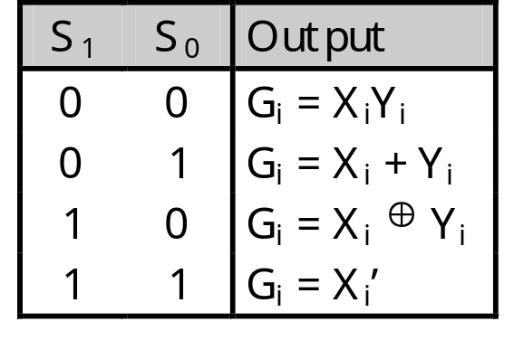
Defining a logic unit
A logic unit supports different logical functions on two multi-bit inputs X and Y, producing an output G.
This abbreviated table shows four possible functions and assigns a selection code S to each.
We’ll just use multiplexers and some primitive gates to implement this.
Again, we need one multiplexer for each bit of X and Y.

Slide 17
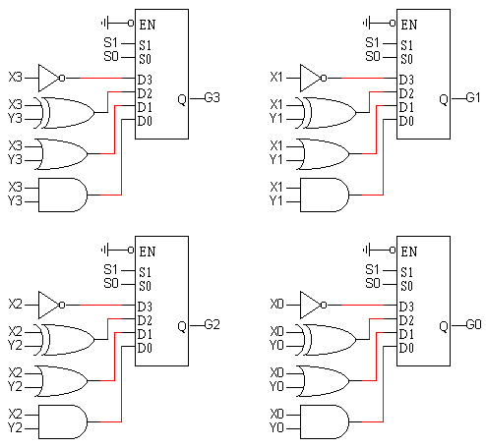
Our simple logic unit
Inputs:
  X (4 bits)
  Y (4 bits)
  S (2 bits)
Outputs:
  G (4 bits)

Slide 18
Combining the arithmetic and logic units
Now we have
  An arithmetic unit that can compute eight functions on 4-bit inputs.
  A logic unit that can perform four functions on 4-bit inputs.
We can combine these together into a single circuit, an arithmetic-logic unit (ALU).

Slide 19
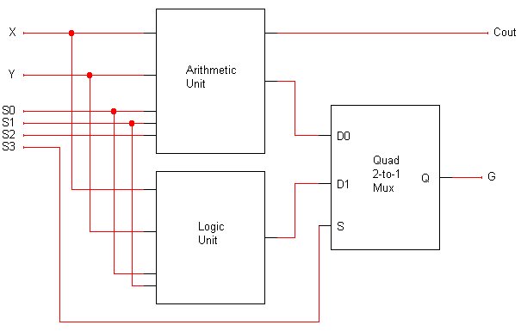
A complete ALU circuit
The / and 4 on a line indicate that it’s actually four lines.
4
4
C_{out} should be ignored when logic operations are performed (when S3=1).
4
4
4
G is the final ALU output.
When S3 = 0, the final output comes from the arithmetic unit.
When S3 = 1, the output comes from the logic unit.
The arithmetic and logic units share the select inputs S1 and S0, but only the arithmetic unit uses S2.

Slide 20
Comments on the multiplexer
Both the arithmetic unit and the logic unit are “active” and produce outputs.
  The mux (multiplexer) determines whether the final result comes from the arithmetic or logic unit.
  The output of the other one is effectively ignored.
This is a very common use of multiplexers in logic design.

Slide 21
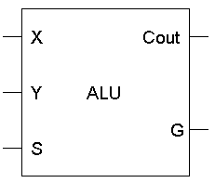
The completed ALU
This ALU is a good example of hierarchical design.
  With the 12 inputs, the truth table would have had 2¹² = 4096 lines.
  Instead, we were able to use components that we’ve seen before to construct the entire circuit from a couple of easy-to-understand components.
As always, we encapsulate the complete circuit in a “black box” so we can reuse it in fancier circuits.
4
4
4
4

Slide 22
ALU summary
We looked at:
  Building adders hierarchically, starting with four-bit full adders.
  Representations of negative numbers to simplify subtraction.
  Using adders to implement a variety of arithmetic functions.
  Logic functions applied to multi-bit quantities.
  Combining all of these operations into one unit, the ALU.
Where are we now?
  We started at the very bottom, with primitive gates, and now we can understand a small but critical part of a CPU.
  This all built upon our knowledge of Boolean algebra, Karnaugh maps, multiplexers, circuit analysis and design, and data representations.

